Slide 1
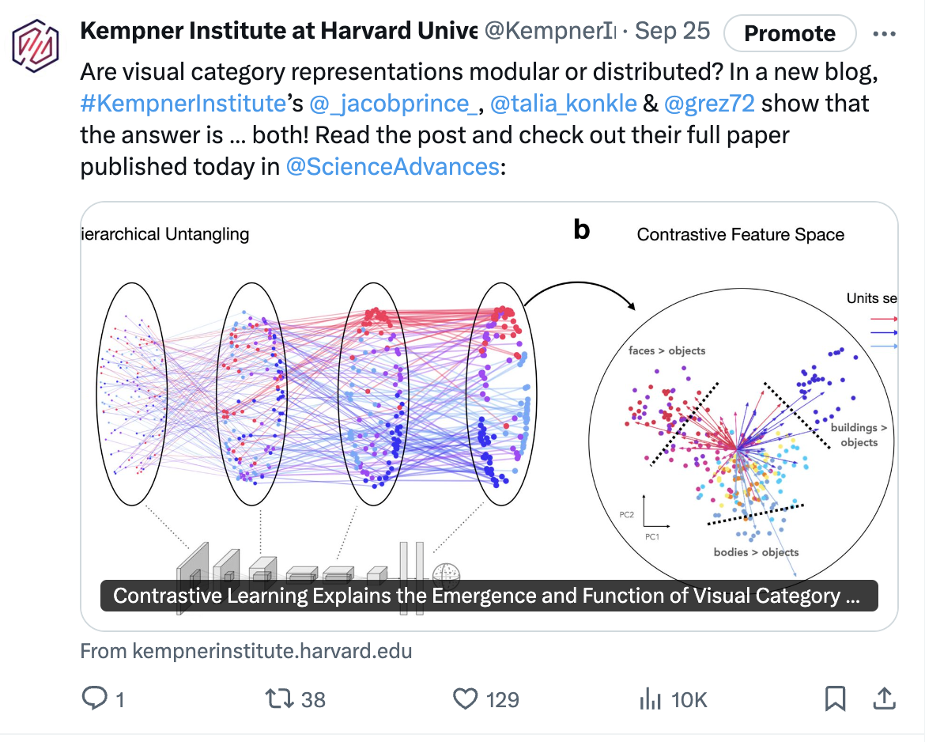
Deeper Learning: the Kempner’s research blog
Sample blog post (on Twitter/X)
What is it?
Features and publicizes new findings and research
Posts timed with release of a preprint or paper
At least one author affiliated with the Kempner
10K impressions, 38 RTs
Why submit?
Publicize new research & gain a wider audience
Share open-source findings/code
Past posts have received up to 1000+ site views
Individual posts have seen up to 22K+ Twitter/X impressions

Slide 2
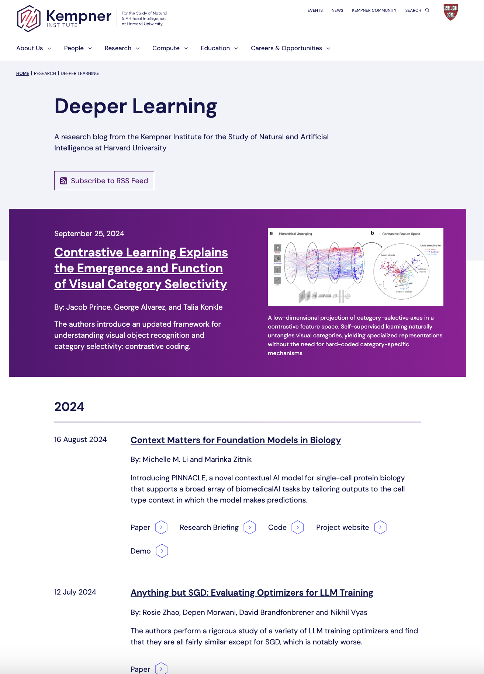
Deeper Learning
How to submit?
Email/Slack deborah_apsel_lang@harvard.edu w/:
topic idea (a few sentences)
forthcoming paper/preprint info
approximate publication date
Sham and Bernardo review/approve
If approved, you draft the post
We edit, coordinate publication, and take it from there!
Please contact Deborah with any questions.

